Slide 1


New Office Development for Sale
1652 Keller Parkway, Keller, TX
SALE PRICE: $1,946,250
($225sf)
BUILDING SIZE: 8,650 sf
Expected delivery January 2019
Matt Matthews
Market Director
817-328-1183
matt@kwc-dfw.com
Moore Matthews
Managing Director
817-328-1183
moore@kwc-dfw.com
A Keller Williams Southlake Affiliate
Each office independently owned and operated

Slide 2
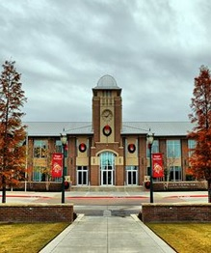
Property Description
Property Overview
Located in one of the most desirable communities in the DFW Metroplex.
Property Details
High end finish out
Expected delivery January 2019
Monument signage
1,000 - 6,500sf available
Walking distance to shopping and restaurants at Keller Crossing Retail Center
Exterior building signage available
Market Overview
Keller is located in the heart of the DFW Metroplex. It has all of the comforts of a big city, yet exhibits a small town charm. Conveniently located within 30 miles of Dallas, Fort Worth, and DFW Airport is just one of the many reasons it is growing much faster then the national average.
Demographics
Daytime Population: 80,772
2018 Population: 114,031 (3 miles)
Average Household Income: $123,736
Median Age: 34.3
Estimate Per Capita Income: $40,286
Households: 37,065
Projected Annual Growth 2018-2023 : 1.77%
“BIG CITY, YET SMALL TOWN CHARM”

Slide 3
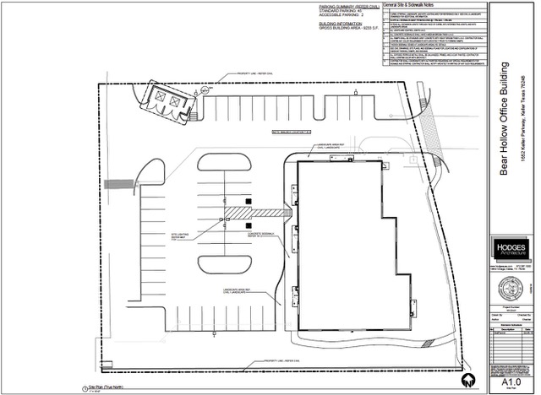
39,054 Vehicles Per Day (STDB)
Floorplan

Slide 4
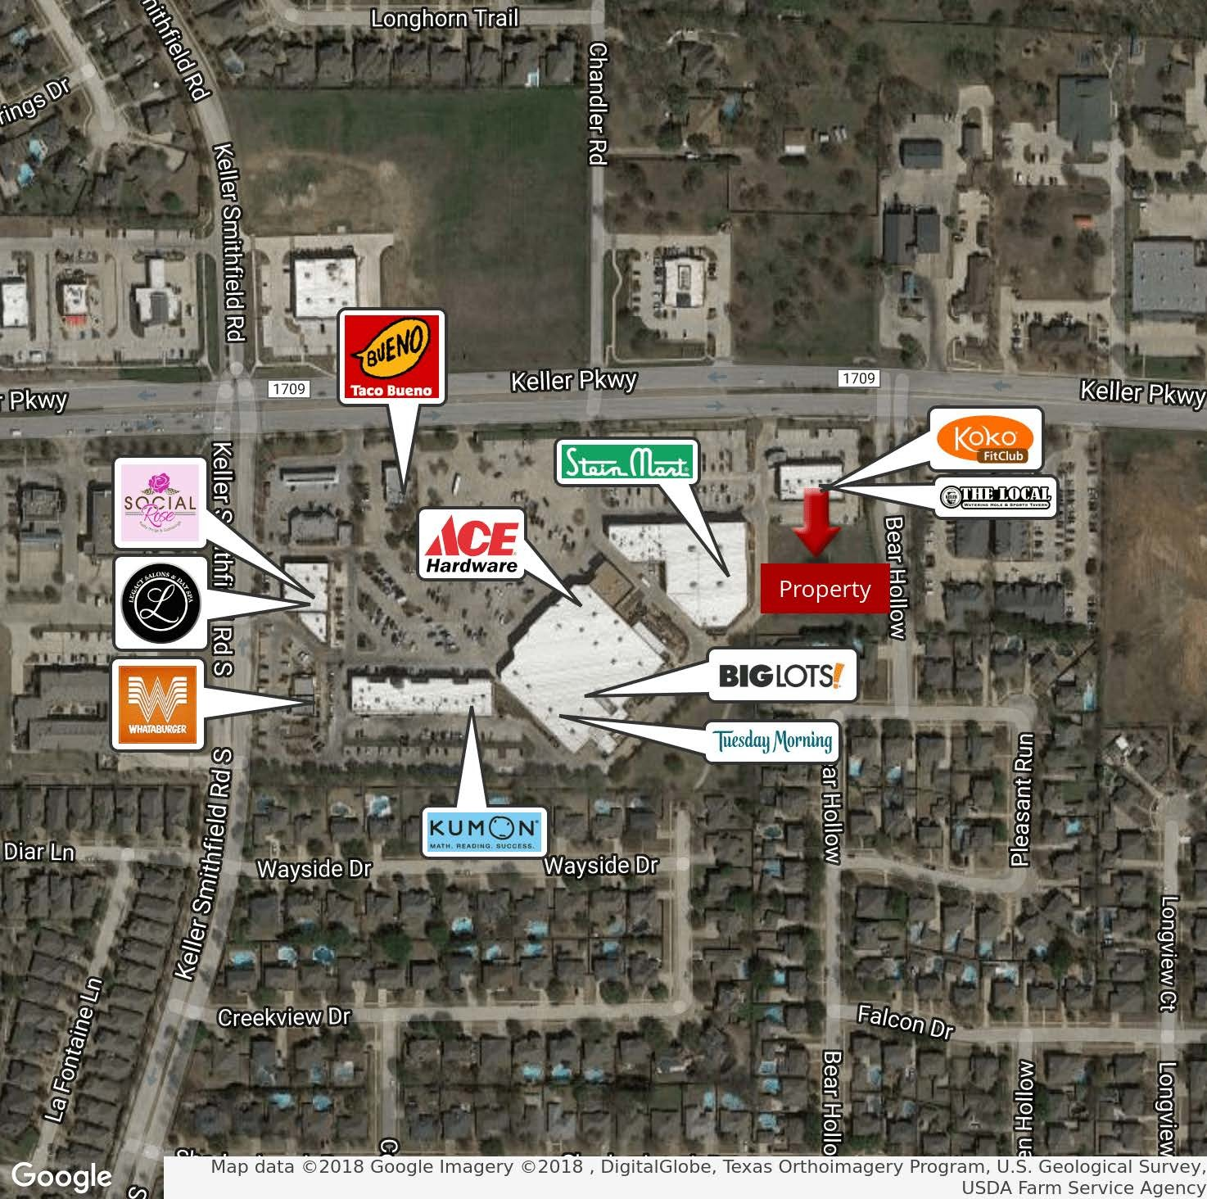
Retail Map

Slide 5
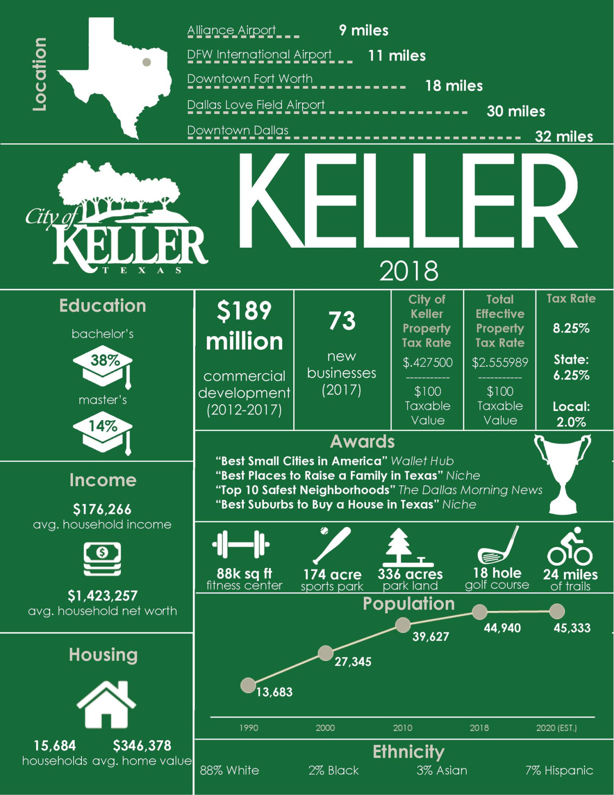

“Best Small Cities in America”
-Wallet Hub
“Best Suburbs to Buy a House in Texas”
-Niche
“Top 10 Safest
Neighborhoods”
-The Dallas Morning News
“Best Places to Raise a Family in Texas”
-Niche
“Tree City USA, 25th Anniversary”
-Arbor Day Foundation
“The Safest Cities in Texas 2018”
-National Council for Home Safety and Security
“7 Dallas-Fort Worth Suburbs with the Best Downtowns”
-Neighborhoods.com

Slide 6
